Slide 1

Notes:
Holding/Welcome Slide

Slide 2


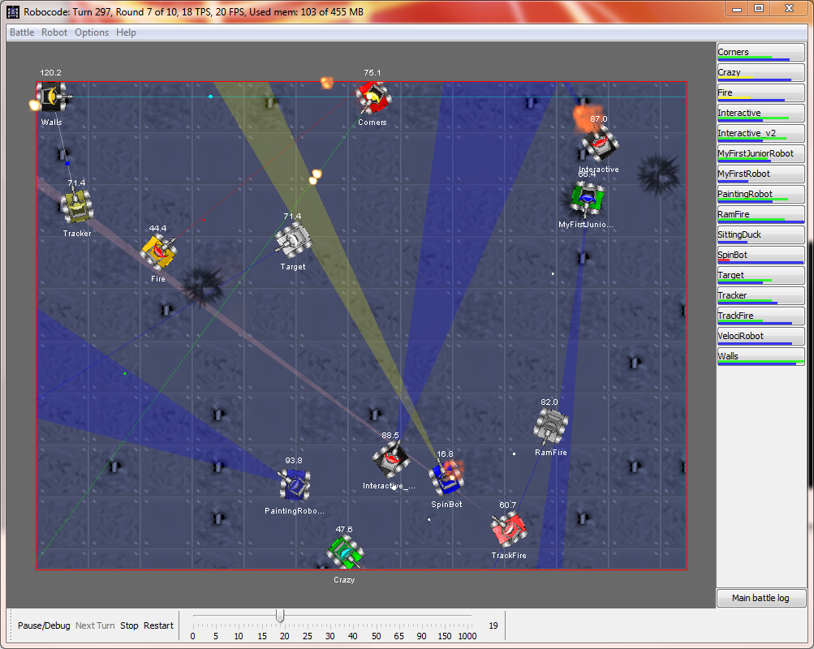


Slide 3
Agenda
0915 | Introduction to the Coding Challenge
0945 | Coding Challenge
1200 | Lunch / Battles
1300 | Coding Challenge
1530 | Battle
1600 | Retrospective
1700 | Wrap Up & Prizes
1730 | Bowling

Slide 4

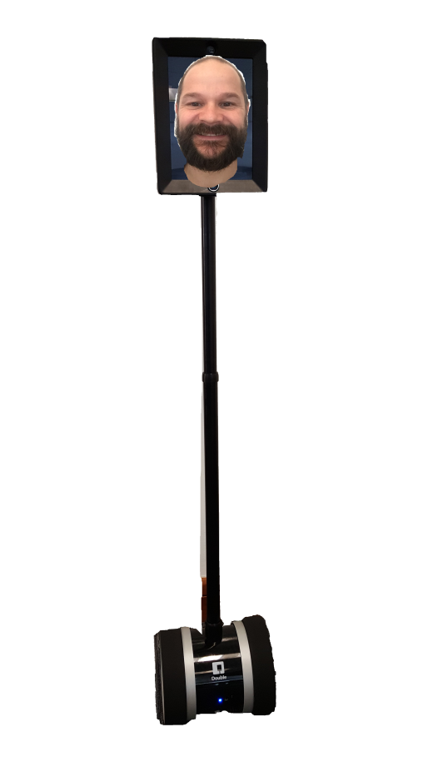
Name your team
Use Basic Robots
Take turns at coding
Earn Bonus Points & Prizes
Use the Kings trusted aides!!!
Take breaks
Be mindful of the noise level
Notes:
Explain that the ultimate goal is a battle against the other teams

Slide 5
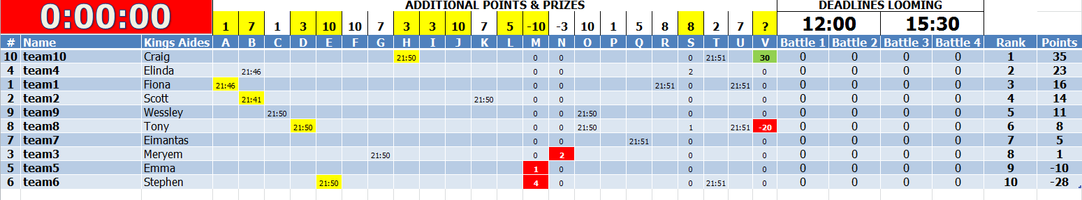
The Scoreboard & Prizes
Notes:
Explain that the ultimate goal is a battle against the other teams

Slide 6
Tips & Advice
Work as a Team (participate fully)
Keep it Simple
Fail Fast
Test, Test, Test
Think Differently
Manage your time
Have fun!!!
Notes:
Basic robots only to ensure a level playing field
They will have to use java as the machines will not have internet connections to utilise any other software
Although each person must code, we should encourage this in a positive way, not dictated to the students as some will have limited tech experience, we need to encourage those with limited experience by highlighting this is a safe environment to practice coding and get involved, don’t be afraid to grab that keyboard!

Slide 7
Questions?
Notes:
Basic robots only to ensure a level playing field
They will have to use java as the machines will not have internet connections to utilise any other software
Although each person must code, we should encourage this in a positive way, not dictated to the students as some will have limited tech experience, we need to encourage those with limited experience by highlighting this is a safe environment to practice coding and get involved, don’t be afraid to grab that keyboard!

Slide 8

Notes:
Questions!

Slide 9

King Robbie The Robot T100 (Beta)
Notes:
Explain that the ultimate goal is a battle against the other teams

